Slide 1
National Info day- General presentation
Susanna GALLONI, CINEA
Lara TASSAN ZANIN​, CINEA
Rowan STEELE, DG Clima
January 29 2026

Slide 2
Disclaimer
The event and its recording as well as the presentation support materials, are made public to provide potential applicants with general guidance to help them complete their proposals.
If there is any conflict between:
the information provided during the Info day session itself, its recording, the Financial Information File tutorial recording, and the presentation support materials on the one hand, and the provisions set out in the official call text for the Innovation Fund calls for Industrial Heat Decarbonisation Auction, Hydrogen Auction and Net Zero Technologies as well as the related FAQs posted on the EU Funding & Tenders portal on the other,
the latter two documents take precedence over the materials from the Info day and act as the text of reference for the IF25 Industrial Heat Decarbonisation Auction, the IF25 Hydrogen Auction and the IF25 Net Zero Technologies calls.
The information provided at the Info Day is not of a binding nature and without prejudice to the assessment of the submitted proposal(s).

Slide 3
Agenda
9:45 Introduction/Policy Update - Rowan STEELE
9:50 NZT Call (45 mins) - Susanna GALLONI, Lara TASSAN ZANIN
10:45 Do Not Significant Harm - Rowan STEELE
10:50 Heat Call - Rowan STEELE
11:05 Hydrogen Call - Lara TASSAN ZANIN
11:10 Q&A (20 mins)
11:30 Coffee Break

Slide 4
Evolution of the Innovation Fund
Adapting to an evolving industrial and political context
2020 - 2022
Since 2023
2024
2025
Two calls per year
Net-zero call
(5 topics)
RFNBO-H₂ auction call
→ EU H₂ bank
Net-zero call
(5 topics)
Dedicated budget for clean-tech manufacturing and for pilots
RFNBO-H₂ auction
Battery manufacturing call
Net-zero call
(5 topics)
Hydrogen Auction
Large, medium and small-scale projects
Raised CAPEX for Small-scale (€20M)
Topic dedicated maritime
Heat Auction (new)
For both RFNBO and low carbon H₂
Topic dedicated to maritime and aviation
Small- & Large-call
11 calls successfully closed, ~2000 proposals received, over €15.8 billion awarded

Slide 5
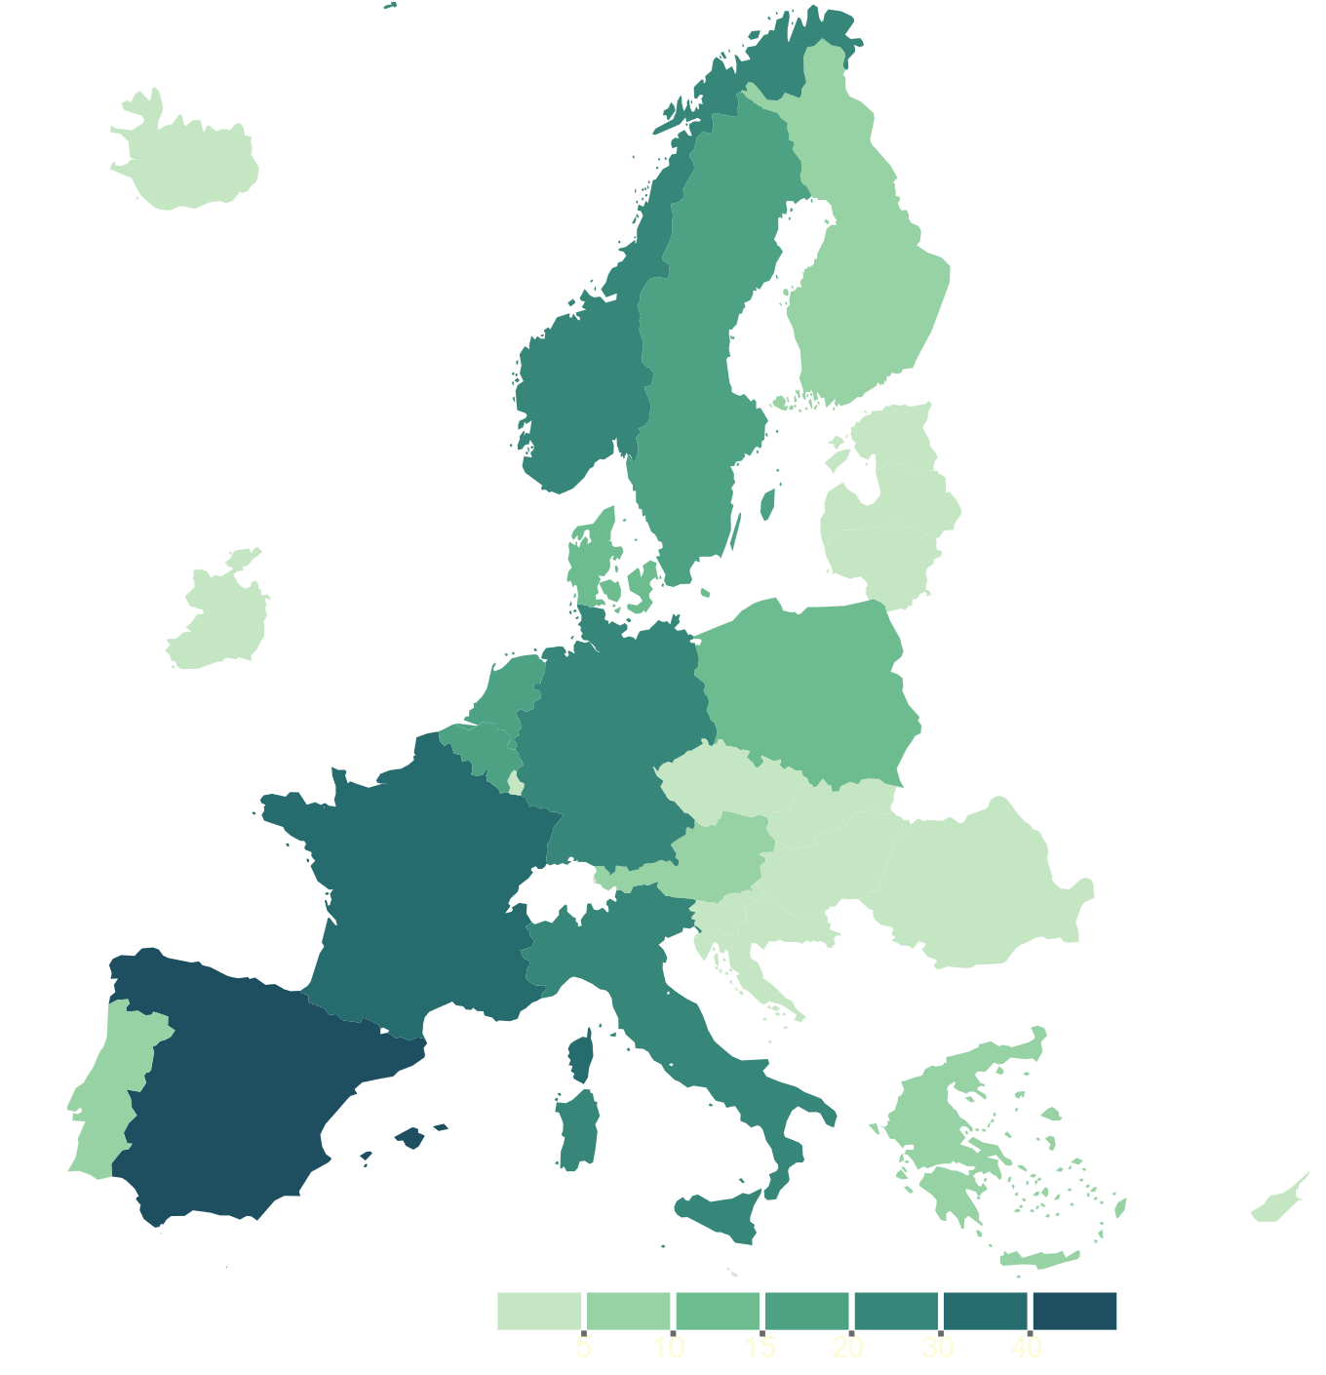




Innovation Fund portfolio
Ongoing projects + Projects from IF24 calls*
276 projects
197 ongoing +
79 under GAP
~€15.8 billion
€11.8 billion allocated
+ €4 billion under GAP
~1 160 MtCO₂e
to be avoided
28
countries
New country in portfolio: Romania
5
10
15
20
30
40
50
Number of projects
GAP: Grant Agreement Preparation
*Projects ongoing as of 30/09/2025, recently signed IF24-Batt and projects from IF24 calls (IF24-RFNBO-AUC + IF24 NZT)

Slide 6


Geographical distribution of the portfolio*
Projects per country
#
Budget
€, Mn
*GAP: Grant Agreement Preparation
Ongoing projects as of end of Q3-2025, including recently signed IF24-battery projects and selected projects from IF24-Calls under GAP
*Ongoing projects as of 30/09/2025. IF24 calls include: IF24 Battery (5), IF24 RFNBO AUC (18), IF24 NZT (61)
Notes:
Geographical distribution with projects implemented in 28 different Member States

Slide 7
Innovation Fund Portfolio by sector
Number of projects
#
Energy intensive industries –
Including ICM and CO2 storage
Renewables
  Energy
  storage
Net-zero mobility
& Buildings
Share by # of projects
60% | 20% | 8% | 6% | 6%
GAP: Under Grant Agreement Preparation

Slide 8



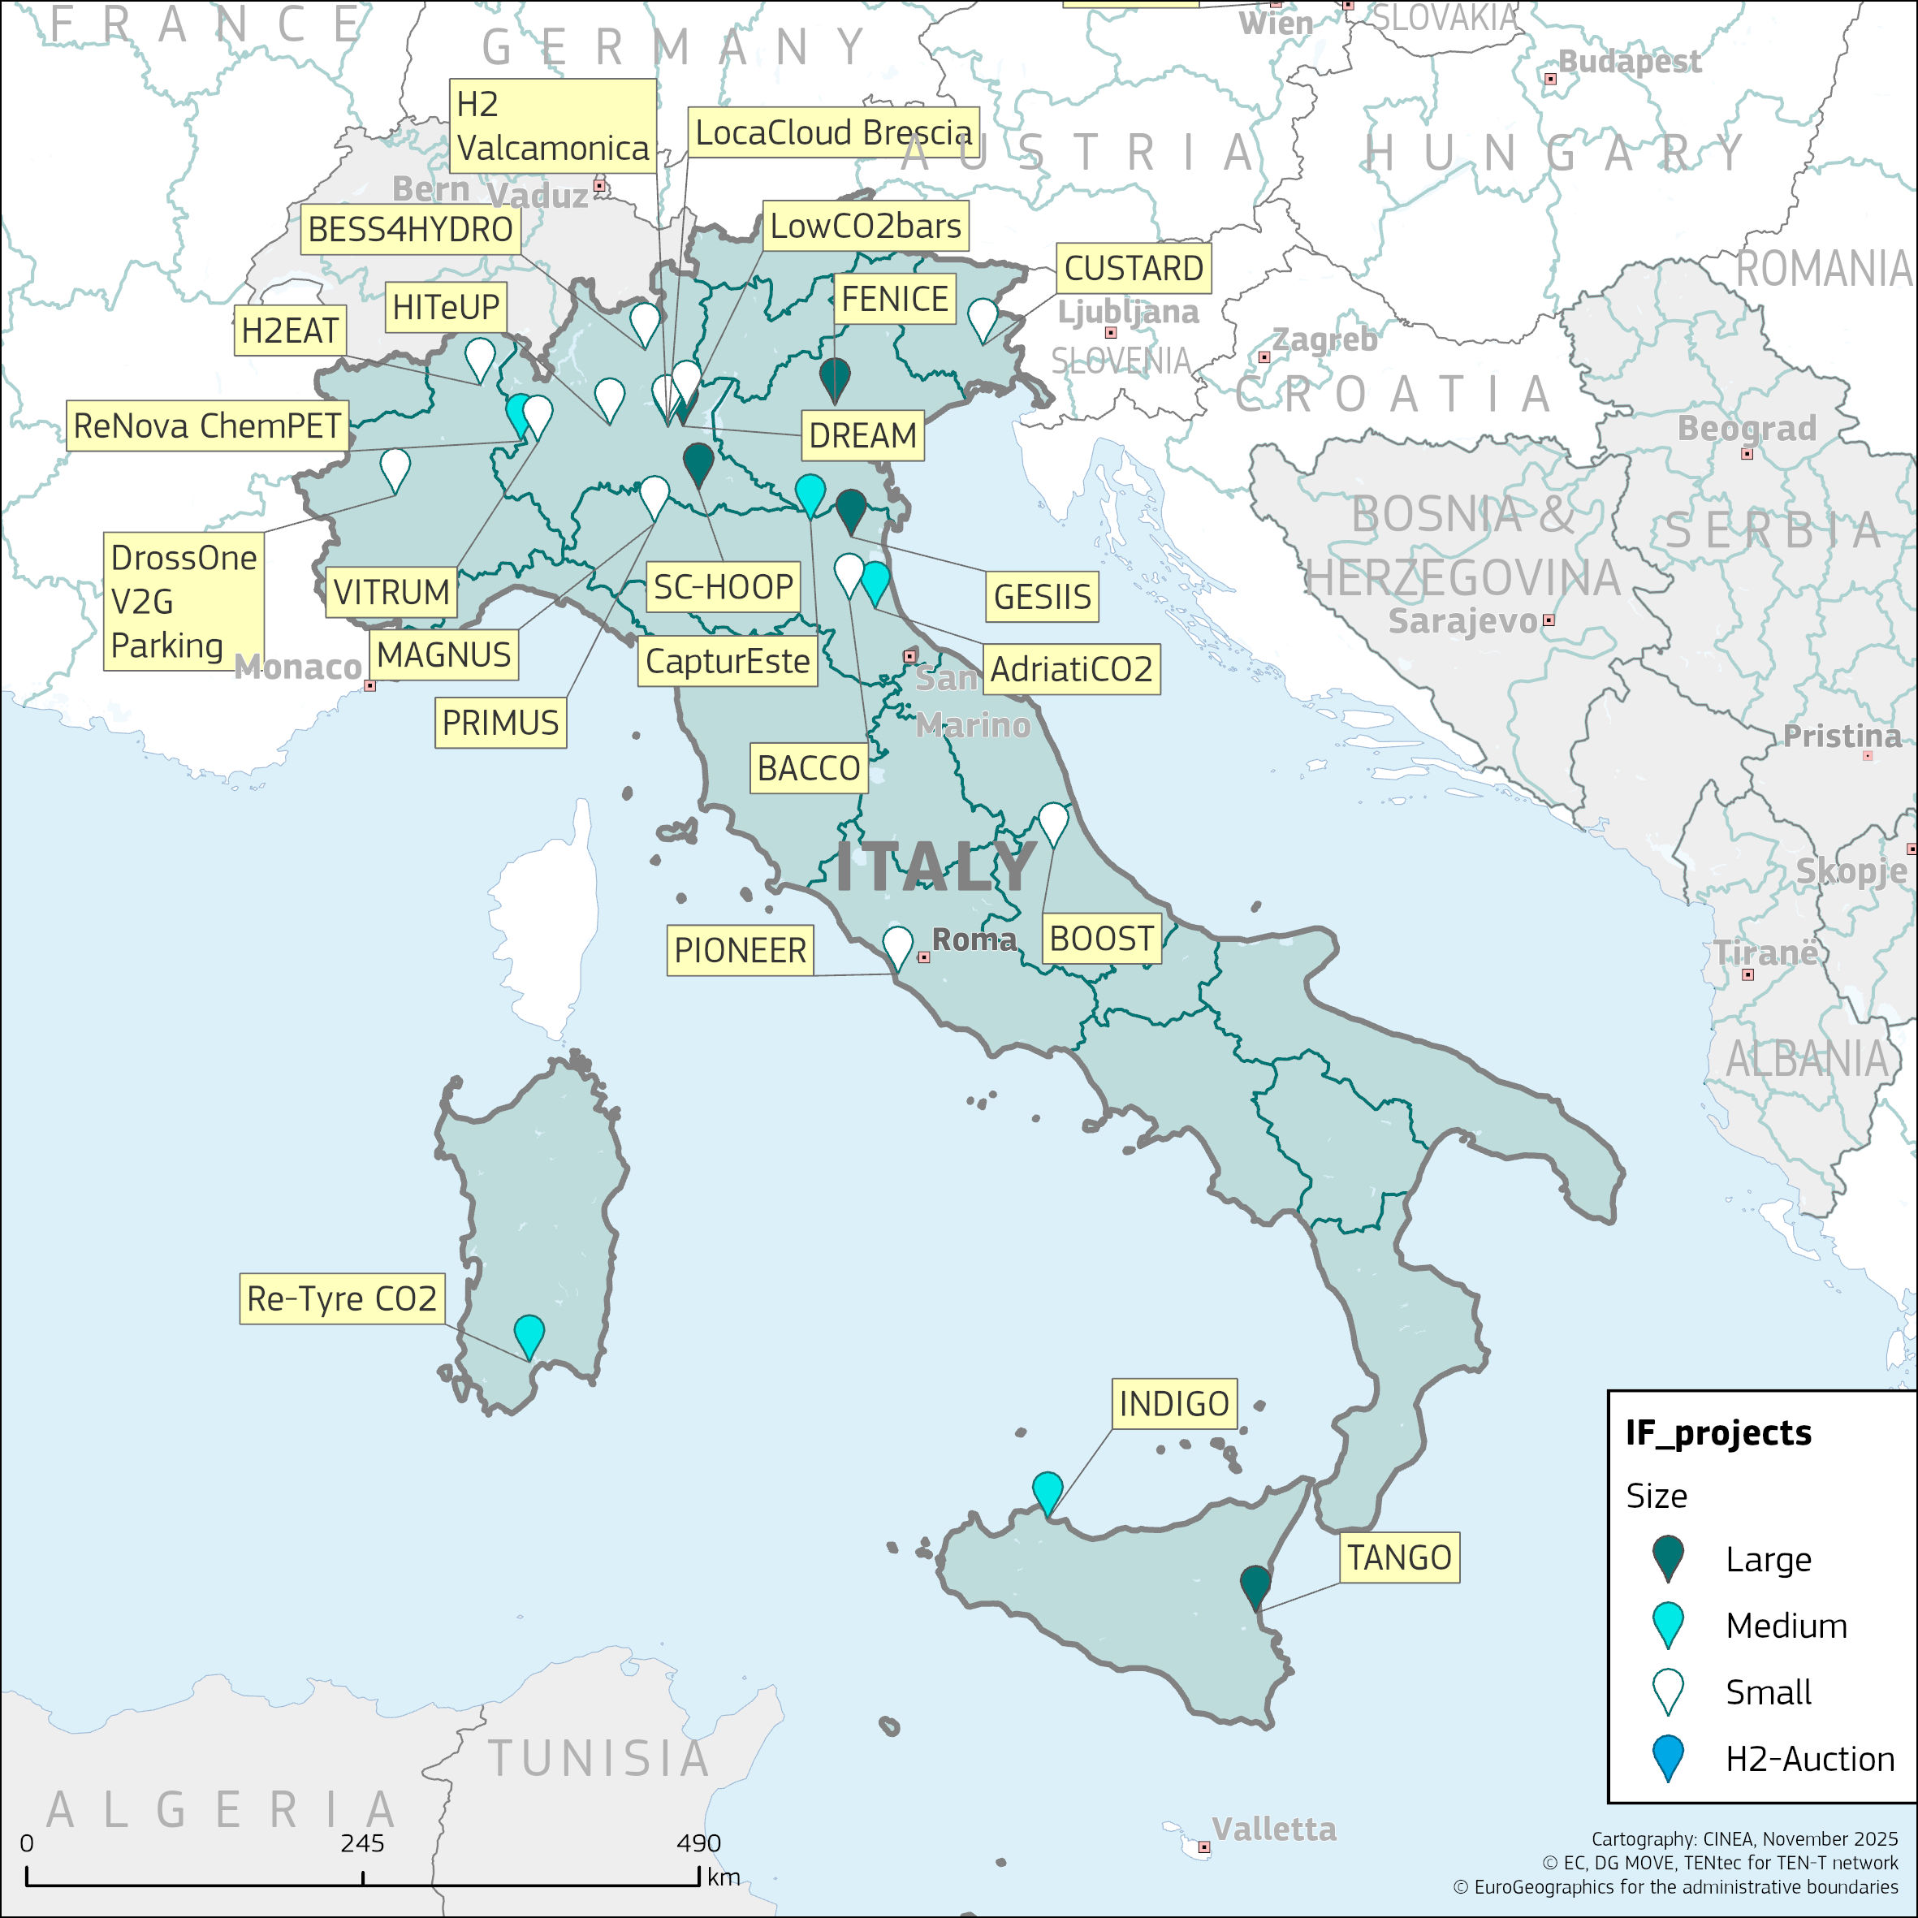
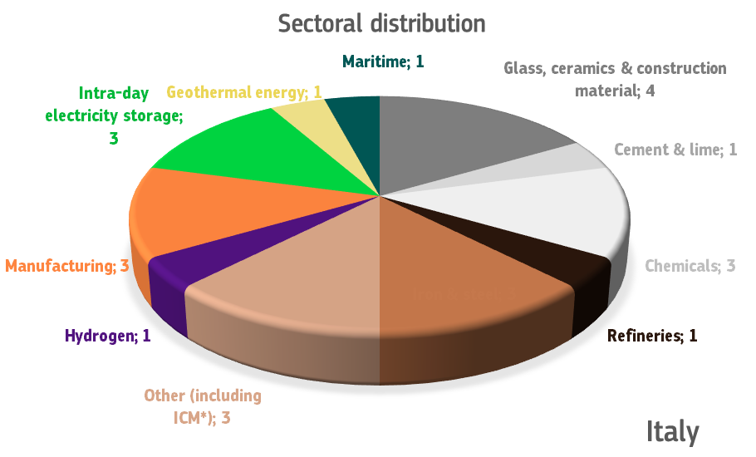
Innovation Fund – Overview of ongoing projects + projects selected from IF24 calls
Italy
24
Projects¹
562 million €
EU contribution
42.3 MtCO₂ eq
first 10 years
¹Based on ongoing projects by 30/09/2025 + projects from IF24 Calls

Slide 9
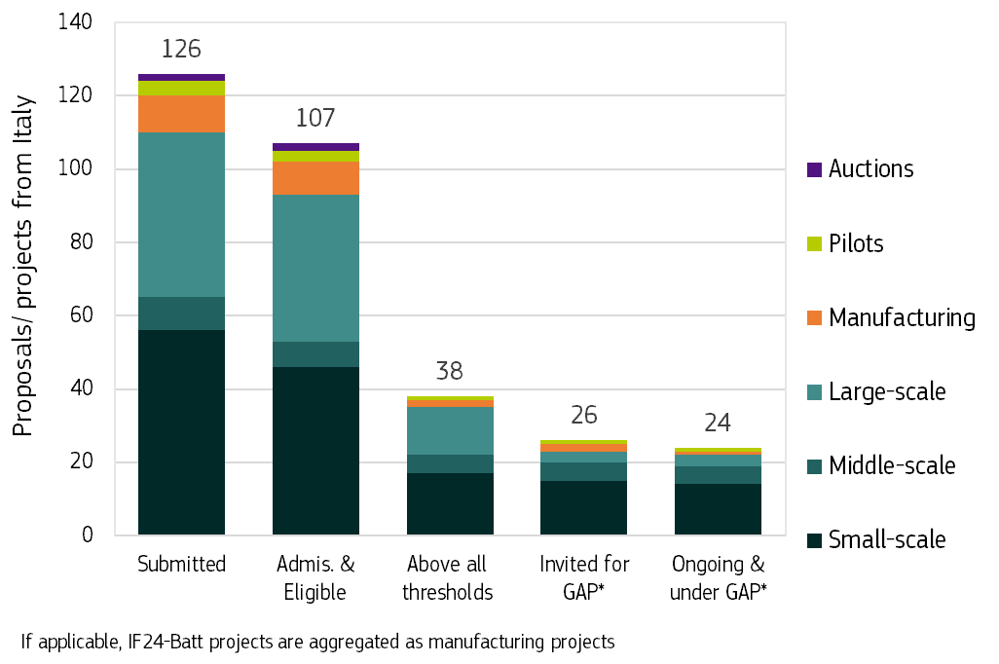


Italy
Performance through Innovation Fund calls
21% success rate
18 projects with STEP seal¹
The STEP seal has been awarded to proposals passing the evaluation process for the NZT-2023, NZT2024 and IF24 Battery call
*GAP: Grant Agreement Preparation
1 Based on ongoing projects by 30/09/2025 + projects from IF24 Calls

Slide 10
Which call should you apply for?
IF25 Hydrogen Auction
RFNBO hydrogen production
IF25 Industrial Heat Auction
100-400°C - thermal capacity 3-5MW
100-400°C - thermal capacity > 5MW
IF25 NZT Call
Innovative commercialisation, demonstration, pilot plant or scale up of technologies, business models and processes that reduce GHG emissions
RFNBO and/or low-carbon electrolytic hydrogen production
RFNBO and/or low-carbon electrolytic hydrogen production for maritime and aviation sectors
> 400°C - thermal capacity > 3 MW
Q&A
Funding and tender portal

Slide 11
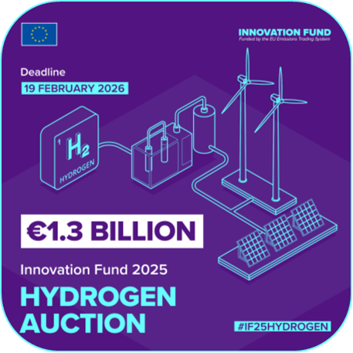

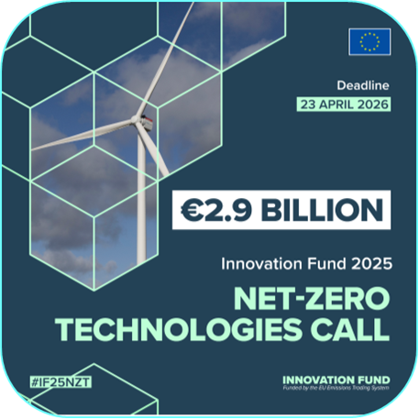
IF25- CALLS – additional information
IF25 H2 AUCTION
Closing date: 19/02/2026
Budget: € 1.3 billion
Info day recording and presentation
Q&A
Funding and tender portal
IF25 HEAT AUCTION
Closing date: 19/02/2026
Budget: € 1.0 billion
Info day recording and presentation
Q&A
Funding and tender portal
IF25 NZT
Closing date: 23/04/2026
Budget: € 2.9 billion
Info day recording and presentation
Q&A
Funding and tender portal

Slide 12
IF25 Net Zero Technology Call
Notes:
[Take the pass / welcome]
So after this great introduction to our Fund, its role and its success so far, it’s time to present you the IF25 Call.
I am Kostis Sakellaris, policy officer in DG CLIMA, and I will take you through the main elements of our new Call, as well as some differences with the previous ones.
I will begin with three slides that summarise:
the main elements of the Call,
its topics and their corresponding budget, and
its award criteria.
For the ones that are familiar with the IF25 Call, you will see that the difference with the IF24 Call – but also IF23 Call - are quite limited. This is because the previous Calls have been very successful, addressing EU’s main policy priorities, while any weaknesses that were identified were corrected. I will nevertheless present you some further improvements we are introducing with our new Call.
Finally I will present in more detail the different topics and a number of important aspects related to each of them.

Slide 13



IF25 NZT call in a nutshell
AWARD CRITERIA
Launch 4 Dec. 2025
Deadline 23 April 2026
Results Q4 2026
Degree of innovation
GHG emission avoidance potential
Project maturity
Replicability
Cost efficiency
Bonus points: Net Carbon Removals, SMEs, Projects in the Maritime Sector
€2.9 billion for grants
Project Development Assistance
STEP Seal
Possibility of “Grants-as-a-Service”
GRANT DISTRIBUTION
LUMP-SUM contribution grant up to 60% of relevant costs
up to 40% of grant at financial close
remaining amount of at least 60% after financial close
generally, at least 10% after entry into operation
Five topics
Notes:
The IF25 Call was launched about 10 days ago, on December 4th. I hope you all had a chance to go through its text, as this will make it easier for you to follow today’s Info Day.
The most important date you should keep in mind and use it as a basis to plan your work is the Call’s deadline on the 23rd of April 2026.
I need to emphasise here that the NZT Call is both very competitive and demanding in terms of the application process. Therefore, in order to prepare a good proposal, it’s critical to familiarise yourselves with the different elements and methodologies associated with the IF as soon as possible, especially if you are new to our instrument. Please do not wait until last minute to start preparing your application!
After the closing of the applications deadline, the evaluation process will be run by CINEA and will take over the summer, with results expected in the fourth quarter of 2026. The evaluation covers, apart from a check on admissibility and eligibility, five main award criteria. It is performed by independent external experts contracted by CINEA. The criteria may have a weight and a minimum threshold which proposals need to meet in order to be ranked for funding.
The total budget of the Call is € 2.9 billion, split into 5 different topics, each with each own budget. The successful proposals are ranked per topic until the budget is exhausted. The projects selected for funding can sign a GA for a lump-sum grant up to 60% of the relevant costs of the project.
As presented by Stefanie before, all projects succeeding the Call get automatically the STEP Seal. Unfortunately the possibility of the GaaS has not been activated by any MS for IF25, which could also help some additional high quality projects to be submitted. Finally, for the projects that are either unsuccessful or do not manage to get in the funding range, there is always the possibility to apply for PDA offered by EIB, where project promoters can improve their investment readiness and better prepare for Innovation Fund calls for proposals. There will be a relevant presentation in the afternoon.

Slide 14
IF25 NZT call – Topics
Topic | Capital Expenditure | Topic budget | Sectors covered
Large-scale projects | above €100 million | €1 200 million​ | Annex I and Annex III to the EU ETS Directive 2003/87, including CCU and development of substitute products Carbon Capture and Storage (CCS) Renewable energy and energy storage technologies Maritime and aviation
Medium-scale projects | between €20 million and €100 million | €300 million​
Small-scale projects | between €2.5 million and €20 million | €100 million​
Clean-tech manufacturing for components* | above €2.5 million | €1 000 million​ | Renewable energy Electrolysers and fuel cells Energy storage solutions Heat pumps
Pilot projects | above €2.5 million | €300 million​ | Validating, testing and optimising highly innovative, deep decarbonisation solutions in all sectors eligible for Innovation Fund support
* Components also include final equipment such as wind turbines, solar panels, batteries, heat pumps or electrolysers.
Notes:
Moving now to the topics of the IF25 NZT Call. The topics can be grouped in three categories.
The first category concerns the general decarbonisation topics. It is split into three subcategories, based on the size of the project.
In particular…. [Present the split based on capital expenditure and mention the topic budget in each case, as well as sectors covered]. Compared to last year the budget of MSP has been increased by € 100 million.
Then we have again the topic on clean-tech manufacturing, supporting among others the implementation of NZIA. Its budget has been increased by € 300 million to €1 billion, to reflect that this time it again covers EV battery manufacturing, which was excluded last year due to the dedicated Battery Call. [Present again capital expenditure and sectors / components covered].
Finally we have the Pilot topic, covering the same activities as the general decarbonisation topic, but focusing on highly innovative, disruptive or breakthrough technologies for deep decarbonisation needed for achieving the climate neutrality goal. It’s budget for IF25 was increased to €300 million.

Slide 15
IF25 NZT call award criteria
Degree of Innovation
GHG emission avoidance potential
Project
maturity
Replicability
Cost efficiency
  Innovation beyond state of the art at European level (except SSP – European or national level)
  ! Consider ongoing IF projects !
  Absolute emission avoidance
  Relative emission avoidance
  Quality of calculation and minimum requirements
  Efficiency gains and multiple environmental impacts (including DNSH)
  Contribution to Europe’s industrial leadership and competitiveness
  Cost efficiency ratio (different formula for Pilot projects)
  Quality of the relevant cost calculation and minimum requirements
  Technical maturity
  Financial maturity
  Operational maturity
Bonus points:
    Net Carbon Removals
    Projects coordinated and implemented by SMEs
    Maritime sector projects
Notes:
The overall design for the award criteria has been maintained. [Mention at least their titles and sub-criteria]
I am not going to spend on these, as they will be presented to you in detail a bit later. I would like though to mention three points.
First, in relation to the Degree of Innovation, you need to consider our continuing number of ongoing projects and justify how your proposal is different from them. Of course this justification should be based on publicly available information about the innovative elements and details of the ongoing Innovation Fund projects. We are thus continuously trying to make more and more information available. Public information about the existing Innovation Fund projects can be found in various websites and different sources, such as the DG CLIMA and CINEA Innovation Fund websites, including project factsheets & stories, as well as the IF dashboard. You can also find additional information, including project public deliverables, on the EU Funding & Tenders Portal, as well as on the project websites.
Second, in relation to the Replicability award criterion, it was important to further refine it and make it more specific. So now we have only two sub-criteria, from three last year.
Finally, the scores in the five award criteria will be complemented by bonus points, which from four last year are reduced to three. More details on this in the next slide and the presentations following.
(for personal reference):
DG CLIMA – Innovation Fund Projects
CINEA – public dashboard
EU Funding & Tenders Portal

Slide 16
Limited changes compared to IF24 NZT call
DNSH compliance
Project activities need to comply with the “do not significant harm” principle. DNSH alignment is assessed during proposal evaluation.
Changes in eligibility criteria
Manufacturing of EV battery cells now eligible. Activities primarily aimed at electricity generation from non-recycled fossil fuels, as well as activities for fossil fuel production based on non-recycled fossil feedstocks are not eligible.
Rationalising access of hydrogen production projects to IF funding
Hydrogen production projects eligible for the IF25 H2 Auction are excluded from the Large and Medium-scale Projects Topics, but are still eligible under the Pilot and Small-scale Projects Topic.
Refinements and clarifications
Improved call text clarity, most notably on: (a) scope of Pilot topic and its evaluation under DoI, (b) refinement of Replicability award criterion, (c) clarifications on required supporting documents.
Changes in the Bonus Points – New Bonus Point for SMEs
New bonus point for projects coordinated and implemented only by SMEs. Replacing previous bonus points for (a) other GHG savings, and (b) electricity from additional RES or to use RFNBOs.
Notes:
Let’s see now what are the main changes compared to IF24 NZT Call. This should be the part most interesting for the ones familiar with our Calls.
Our limited changes aim to ensure stability in the regular grants call design and evaluation criteria, while improving clarity wherever necessary to applicants.
DNSH compliance
The ETS Directive provides that from 2025, the ETS revenues destined for the Innovation Fund should be used in accordance with the DNSH criteria set out in Article 17 of the Taxonomy Regulation. Therefore, project activities need to comply with the “do not significant harm” principle. My colleague Rowan will go into more details right after my presentation.
Changes in eligibility criteria
Here we needed to do two changes. One concerned the manufacturing of EV battery cells, which are now eligible, since we won’t have a Battery Call like last year.
The other, was making more clear which are the non-eligible activities related to non-recycled fossil fuels. In particular, we found it important to clarify that activities primarily aimed at electricity generation from non-recycled fossil fuels, as well as activities for fossil fuel production based on non-recycled fossil feedstocks are not eligible. Production of low carbon fuels, like blue hydrogen, is still eligible. This clarifies a related question we have been receiving, since the deep decarbonisation target of the EU and the IF are not compatible with fossil fuel use.
As explained in the NZT QA, this concerns primary activities, but not transitory. For example, a project that uses natural gas as a primary energy source can be eligible for funding under the Innovation Fund, but only if the natural gas is used as a necessary energy source in a transition phase, and of course the project's innovative aspects result in a significant reduction of greenhouse gases, which would not be achieved without the Innovation Fund's support.
And of course, as mentioned before, activities that do not comply with the ‘do no significant harm’ principle are not eligible.
Rationalising access of hydrogen production projects to IF funding
Considering that projects whose principal product is RFNBO hydrogen and/or electrolytic low carbon hydrogen have a dedicated instrument to support them, the IF25 H2 Auction, we decided to restrict their eligibility in the General Decarbonisation Topic only to Small Scale Projects, provided they fulfil the relevant topic provisions. These projects are also eligible under Pilots, which is a separate topic from the General Decarbonisation ones.
Nevertheless, hydrogen use in industry (i.e. hydrogen use as an energy carrier, reducing agent, or feedstock) can still be funded also under the Large and Medium Scale Project topics.
Changes in the Bonus Points
Following an assessment of IF applications over the previous years, we identified the need to update the bonus points.
In particular, both Bonus Points 2 for other GHG savings, and 3 for electricity from additional RES or to use RFNBOs were found to favour specific sectors and technologies more than other.
On the other hand, we wanted to attract more SMEs and small-scale projects, recognising that SMEs can play an important role in Europe's decarbonisation efforts.
For this reason we replaced previous Bonus Points 2 and 3, by a new dedicated bonus point for projects coordinated and implemented only by SMEs.
Refinements and clarifications
Finally we performed some further refinements, improving call text clarity, most notably on: (a) scope of the Pilot topic and its evaluation under DoI, (b) the description of the Replicability award criterion and (c) certain clarifications related to the required supporting documents.

Slide 17
General Decarbonisation Topic(s)
Important aspects:
Projects must operate at least 5 years after entry into operation or at least 3 years if small-scale project
Contribution to building EU industrial capacity, technology leadership and supply chain resilience
  assessed under Replicability award criterion
Simplification for small-scale projects: degree of innovation can be at national level
Minimum thresholds that need to be fulfilled:
  Relative GHG emission avoidance: at least 50%
  Cost efficiency ratio: max €200/t CO2eq
Notes:
[go through the bullets]

Slide 18
Cleantech Manufacturing Topic
Important aspects (cont.):
If financial close within two (2) years and entry into operation within four (4) years may earn a higher score in project maturity
Projects must operate at least 5 years after entry into operation
Minimum thresholds that need to be fulfilled:
  Relative GHG emission avoidance: min 50%
  Cost efficiency ratio: max 200 €/t CO₂-eq
Notes:
[go through the bullets]

Slide 19
Pilot Projects Topic
Important aspects (cont.):
If financial close within two (2) years and entry into operation within four (4) years may earn a higher score in project maturity
Minimum operation: three (3) years after entry into operation
Minimum thresholds that need to be fulfilled:
  Relative GHG emission avoidance: min 75%
  Less stringent requirements for cost efficiency: max 2000 €/t CO₂eq
  Maximum grant: €40 million
Notes:
[go through the bullets]

Slide 20
Innovation Fund Self-check Questionnaire
Provide an early high-level orientation on potential fit and readiness of project ideas for the Innovation Fund
Entirely independent from the official Innovation Fund application and evaluation process
Available here
Notes:
Finally, for those that are maybe less familiar with the Innovation Fund, you may wish to first check the fit of your proposal using the IF Self-check Questionnaire.
Now, I clearly don’t want to give the wrong signal, it is not a tool aimed to simulate a proposal evaluation. But it does check some basic aspects of your proposal and may help you to get an orientation on the potential fit and readiness of project ideas for the 2025 NZT Call.

Slide 21
General provisions
DOUBRAVA, Head of Unit
CINEA C4, Innovation Fund

Slide 22
Call text and mandatory documentation
IF25 NZT Call text on Funding and Tenders Portal
Application form A
Application form B
Technical description
Administrative information
Up to 70 pages
Part C
Project’s contribution to EU programme KPIs
Mandatory annexes and supporting documents
Detailed budget table/relevant cost calculator
Participant information
Timetable/Gantt chart
GHG emission avoidance calculator
Feasibility study
Business plan
Detailed financial model
Project shareholders’ financial resources
Support to project
Terms of supply
Extended Part C form
Summarised budget

Slide 23
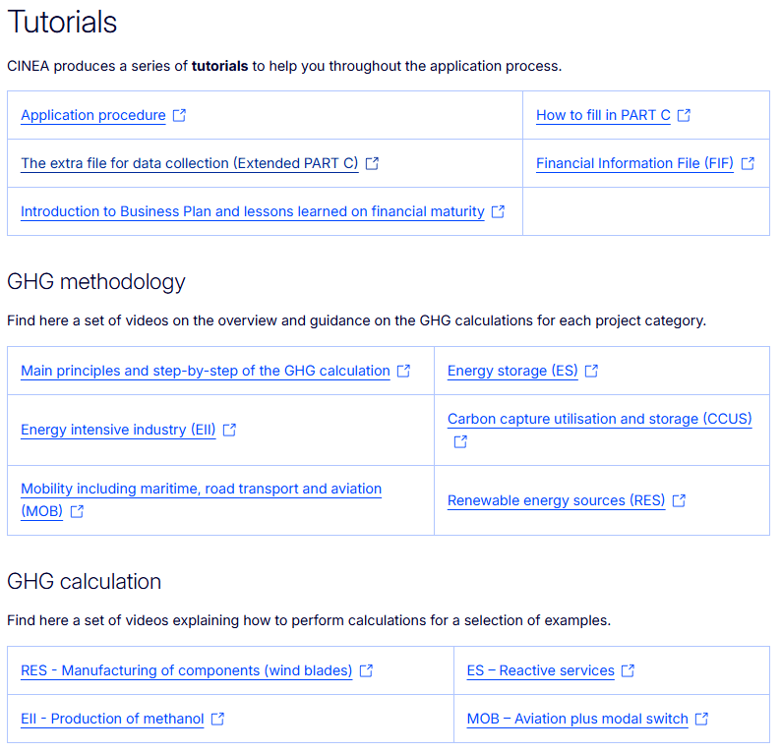
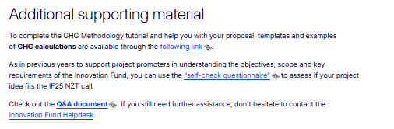
How to apply?
Check all relevant information to apply
Funding and Tenders Portal link
CINEA website
  Tutorials:
    Application process
    How to fill in PART C and the extended Part C form
    Financial Information File tutorial
    Introduction to Business Plan & Lessons Learned on Financial Maturity
    GHG methodology
    GHG calculation
  Info Day recording and slides (available after the event)
  Additional supporting material
    Frequently Asked Questions
    Helpdesk

Slide 24
Geographical location for maritime projects
When the projects concern investments on ships, those ships must:
  Carry a flag of an EU Member States or an EEA country* and call ports under the jurisdiction of an EU Member State or EEA country at least 15% of their calls on ports over two years
  Or must call ports under the jurisdiction of an EU Member State or EEA country* at least 30% of their calls on ports over two years
  Or perform service or support activities in ports under the jurisdiction of an EU Member State or EEA country
When the projects concern investments in ports infrastructure, the ports must be under the jurisdiction of an EU Member States or an EEA country
  Some examples: renewable alternative fuel bunkering infrastructures in ports, including container transhipment ports
*(see the list in the call text)

Slide 25
Evaluation timeline
4 December 2025
Call opening
23 April 2026
Call closing
April- October 2026
Evaluation
Q4 2026
Results
March 2027
Latest Grant Agreement signature
Indicative timeline

Slide 26
Innovation Fund 2025
Net-Zero Technologies Call
Award Criteria

Slide 27
Degree of Innovation

Slide 28
Degree of Innovation
Application form, Part B
Section 1: Degree of innovation
Innovation in relation to the state of the art
Innovation beyond the state of the art
Feasibility study (mandatory document)
A template for the Feasibility study is available in the Submission System (under "Part B templates").
Template recommended to be used!
Any due diligence report (if any)
Notes:
This template is recommended but not mandatory. If you do not use it, please make sure that you submit at least the same level of detail and information to ensure a proper assessment. In case you consider a section not applicable, please mark it and explain why.
State-of-the-art
Describe the state-of-the-art of the solution(s) the project aims to demonstrate.
Cover the characteristics of the commercially available process or service that is most similar to the proposed one (commercial state-of-the-art), the already demonstrated characteristics of the proposed technological solution at the highest technological readiness level (technological state-of-the-art) and, where relevant, the innovative elements already demonstrated/used in other Innovation Fund projects (Innovation Fund Project Portfolio Dashboard).
This should focus on the European, rather than national level (or, f
Innovation beyond state-of-the-art
Describe how the project (technologies/products/services/processes/business models) goes beyond both the commercial and technological state-of-the-art, referring to key performance data evidenced in the feasibility study annex, covering at least:
plant design
operating approach
construction
performance/quality
reliability and availability
maintenance
economics
Describe how the project (technologies/products/services/processes/business models) goes beyond incremental innovation, referring to key performance data evidenced in the feasibility study annex and covering at least:
expected increases in technology readiness level, system readiness level and/or commercial readiness level
the technological and economical barriers to be overcome in the realisation of the project
or NZT-GENERAL-SSP topic, on the European or national level).

Slide 29
Degree of Innovation
The Innovation Fund aims at supporting projects beyond incremental innovation on a scale from intermediate to breakthrough, including scaling-up, considering the European level as reference point (for SSP topic the European or national level)
Very low / incremental innovation
Intermediate or strong
Very strong or breakthrough
Incremental innovation: minor changes or improvements to existing products, processes or business models; implies limited new knowledge / technology; such projects will not be retained.
Intermediate or strong: new or considerably changed technologies or processes or business models; novel combinations of mature technologies; scale-up of innovative technologies
Very strong or breakthrough: completely new technologies or processes or business models; innovations leading to significant changes that transforms entire markets or industries or creates new ones

Slide 30
Degree of Innovation: types of innovative actions
The Innovation Fund aims to support technologies, business models and processes that are not yet commercially available:
First-of-a-kind commercialisation or large-scale commercial size demonstration of technologies, processes or business models previously proven at pilot or smaller scale, or large-scale demonstration plants
A second or more of a kind commercialisation, under certain conditions. In particular, where the relevant costs remain a significant share of total costs that prohibit commercialisation without further public support. Innovation beyond incremental must still be demonstrated.
Innovative smaller demonstrations or pilot plants, especially if this is the right scale at which technology needs to be proven before moving to a larger scale demonstration
Projects aimed at demonstrated scaling up of innovative techniques, processes and technologies for their broad roll-out, which contribute significantly to the decarbonisation of the IF sectors

Slide 31
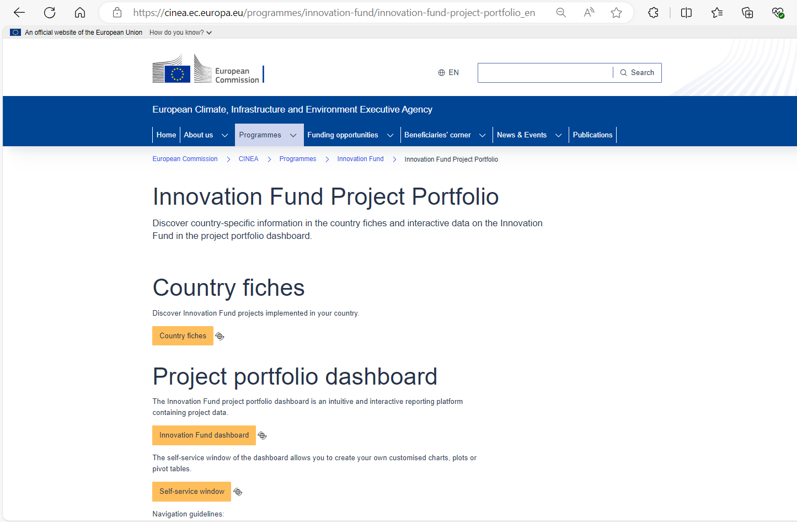
References to Innovation Fund projects
Proposals focusing on innovations similar to the ones of ongoing Innovation Fund projects, must clearly justify where the new innovative elements lie
Such projects may receive a lower score
Consult the list of funded Innovation Fund projects (Innovation Fund Project Portfolio Dashboard)
Notes:
Proposed solution = technologies/products/services/processes/business models
If the proposal focuses on innovations already covered by an IF project which already started its operation, this might be considered by experts not going beyond incremental innovation and the proposal might be rejected under this criterion.
If the solution that the applicant proposes has already been awarded by Innovation Fund, the proposal must clearly justify where the new innovative elements of the proposed project lie (e.g., scale, type of application, difference in some elements).
Proposals aiming at innovations considerably similar to the ones of ongoing Innovation Fund projects may receive a lower score.
Consult the list of funded Innovation Fund projects (Innovation Fund Project Portfolio Dashboard).

Slide 32
Degree of Innovation for topic General - SSP
Innovation at national level:
For small-scale projects (INNOVFUND-2025-NZT-GENERAL-SSP), the reference point can be at European or national level
For innovations at national level: the geographical reference of the state of the art must be the country where the project will be implemented. The proposal should demonstrate how it goes beyond this national state-of-the-art
Proposals going beyond state of the art at national level can meet the minimum threshold of this criterion; however, if a proposal is also going beyond the state of the art at European level, it may receive a higher score
Notes:
Text in the slide is = text in the call document

Slide 33
Lessons learned: Degree of Innovation
Describe
Identify
How does your innovation go beyond state of the art?
Evidence
Costs
Technical characteristics & performance
TRL/SRL
Compare with previous & ongoing EU and IF projects
Provide geographical reference point
Consider barriers: for scaling up & for technology integration
Relevant parameters
Consider also energy efficiency and circularity
Provide patent data (when relevant)
Consider how will the innovation be implemented or integrated?
Compare key performance data vs state of the art
Describe relevant state of the art
Include both technological & commercial aspects
Provide quantitative inputs and evidence for:
Notes:
SRL=system readiness level

Slide 34
GHG emission avoidance
Notes:
We will now move on to the second criterion, that of the GHG emission avoidance.
In particular I will first present the criterion and then I will do a short presentation of the GHG methodology, which governs the calculations for the GHG emission avoidance.
I remind you that in the evaluation of the Innovation Fund we follow a cascading approach. Therefore this criterion will only be evaluated if a proposal scores higher than the minimum threshold in the Degree of Innovation criterion.

Slide 35
GHG emission avoidance potential
Purpose
Section 2: GHG emission avoidance potential
2.1 Absolute GHG emission avoidance
2.2 Relative GHG emission avoidance
2.3 Minimum requirements
GHG emission avoidance calculator (mandatory annex)
Part B, sections:
Critical criterion in awarding funding, prioritising projects that demonstrate substantial, measurable, and verifiable reductions.
Incentivises adoption of innovative technologies and practices that deliver emissions reductions beyond business-as-usual scenarios
Notes:
The GHG emission avoidance criterion is a critical criterion in the awarding decision, since the Fund intends to prioritise innovative technologies and practices that deliver emissions reductions beyond business-as-usual scenarios
It assesses how much and how efficiently a project will reduce greenhouse gas emissions compared to a realistic reference scenario without the project, over a standard 10‑year operating period.
This is assessed via three subcriteria:
The absolute GHG emission avoidance
The relative GHG emission avoidance
Minimum Requirements are met (Quality and robustness of the calculation)
The first two are calculated automatically based on your submissions, while in the third one the evaluators check whether you followed the official GHG emission avoidance methodology (in terms of system boundaries, input categories, emission factors), avoided double counting, and used realistic performance assumptions and consistent data.
I need to highlight also that there is an additional significance to this criterion, as the grant disbursement is dependent to verified emission avoidance. Therefore the GHG savings must be credible, realistic monitorable over time, which are aspects also assessed by the evaluators.
The relevant documents where you need to address the above elements are Application form, Part B, Section2, but also the GHG emission avoidance calculator which is a mandatory annex. Note that the
GHG calculators are published on the Funding and tender portal, while all the supporting material I will mention later on are published on CINEA’s website.

Slide 36
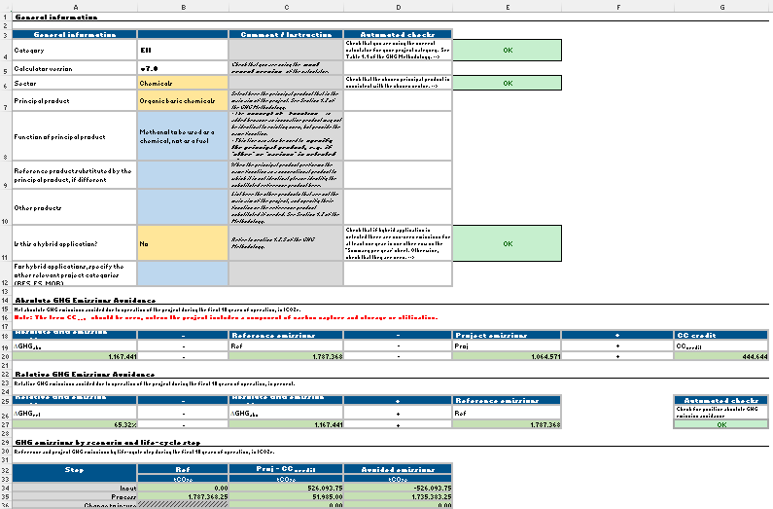

GHG emission avoidance potential
Emission Avoidance
Absolute GHG emission avoidance: difference between the expected GHG emissions of the proposed project and the GHG emissions in the reference scenario during 10 years after entry into operation
Relative GHG emission avoidance: absolute GHG emission avoidance divided by the GHG emissions in the reference scenario over the same 10 years period
  The calculation must be done:
  using the relevant GHG emission avoidance calculator
  following the Methodology for GHG Emission Avoidance Calculation
Notes:
The first two sub-criteria examined are the Absolute and the relative Emission Avoidance. Absolute represents the total GHG reduction achieved by a project compared to a baseline, and the relative, the GHG reduction as a percentage of emissions in a reference scenario.
In particular, the criterion is assessed via two calculations:
First, the absolute GHG emission avoidance
in total tonnes of CO₂‑equivalent avoided over 10 years after EiO (even if monitoring period is lower), by comparing the difference in emissions between:
the project scenario (your technology and system boundaries), and
the reference scenario (what would realistically happen without the project: conventional technology, EU mix, existing standards).
Relative GHG emission avoidance
The percentage reduction vs. the reference scenario (often using ETS benchmarks where available), used to check whether the project meets thresholds like >50% reduction and to rank proposals. This is also based on the 10 years period as above.
The score for these two sub-criteria will be automatically calculated on the basis of the figures provided in the proposal by using the formulas provided in the call text.
The calculations must be performed using the GHG emission avoidance calculator and following the GHG methodology.

Slide 37
GHG emission avoidance potential
Quality and Credibility
Quality of the GHG emission avoidance calculation and minimum requirements:
  External experts will assess the quality and credibility of your calculation of GHG emission avoidance potential
  In case of issues in the quality of the calculation (including reliability and margin of uncertainty of key parameters and/or key assumptions), points may be reduced
  In case the GHG emission avoidance calculation methodology is incorrectly applied or in case the application documents have not been filled correctly, the score for this sub-criterion will be below the minimum threshold and the proposal will be rejected
Notes:
In the evaluation, as the above sub-criteria are automatically calculated, the external experts will assess the quality and the credibility of your calculations.
[read the 2nd and 3rd bullet]

Slide 38

GHG emission avoidance potential
Minimum Requirements
When relevant, the proposal should demonstrate whether the proposed project meets or not the minimum requirements:
  For projects producing products with an EU ETS benchmark: the process emissions of the project per unit of product must be below the EU ETS benchmark(s) applicable at the call deadline
  For projects using biomass feedstocks: the biomass used will at least meet the sustainability requirements of the Renewable Energy Directive
  All projects must demonstrate compliance with the DNSH principle for the environmental objective ‘climate change mitigation’.
  For all projects: the relative GHG emission avoidance must be:
    for all topics except INNOVFUND-2024-NZT-PILOTS: at least 50%
    for INNOVFUND-2024-NZT-PILOTS topic: at least 75%
Proposals not meeting minimum requirements will be rejected!
Notes:
Experts will also check whether the proposal meets the minimum requirements, as set out in the Call text, or not. In the later case, so when it does not meet the minimum requirements, the proposal will be rejected.
[read the four bullets]
(complementing on the last bullet on the pilots) For Pilots the minimum threshold is higher as the aim of this topic is to fund projects that are both very innovative and aim to the deep decarbonisation of the sector.

Slide 39
Lessons learned: GHG Emission avoidance potential
GHG Methodology
Follow the IF GHG emission methodology for calculation and reporting:
Explain
Justify choices made in the application of the GHG emission avoidance methodology, when relevant
Assumptions must be robust and properly justified
Evidence
Back all assumptions and claims with the necessary supporting evidence
Identify principal product(s), select sector, reference scenario and methodology accordingly
Use correct emissions factor(s)
Notes:
So based on the above, in order to increase your chances of success we advise you to:
Read carefully the GHG methodology document, focusing on the parts more relevant for your projects.
Identify the principal products, select carefully the sectors, the project boundaries, the reference scenario and the appropriate methodology accordingly.
Use the correct emissions factors in line with the methodology.
When you have the possibility to make choices in the application of the GHG methodology, justify them.
And always remembers that assumptions must be robust and properly justified.

Slide 40
Bonus point 1
Notes:
I will close this set of slides relevant to the GHG emission avoidance calculation with the Bonus Point associated with it.
In total there are three Bonus Points, two more to be presented by my colleagues later on. Securing these bonus points can improve the proposal’s ranking, particularly when there are many competing proposals with similar scores.

Slide 41
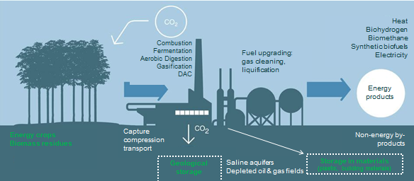
Bonus Point 1: net carbon removal
Application form, Part B, Section 8
Template GHG emission Calculator
Tab "Net carbon removals"
Application form, Part B, Section 6
The total project emissions should be negative
For EII projects, negative emissions can only be claimed excluding any credit for timed operation
For EII projects: the non-principal products are not allowed to be the only source of negative emissions in the projects
Notes:
The first Bonus Point of the three in the Call text will be given to points that demonstrate net carbon removal.
To demonstrate net carbon removal the total project emissions should be negative.
Specifically for EII proposals there are two important points:
Negative emissions can only be claimed excluding any credit for timed operation, as described under Section 2.2.7.4 of the GHG methodology. In other words, negative emissions must come from structural removals that are due to permanent/long‑term removal or storage, not from smart dispatch.
The non-principal products are not allowed to be the only source of negative emissions in the projects. The principal product chain itself must be clearly net‑negative, while negative contributions from non principal products can top up the total, but cannot be the only source.
You will need to provide a well-substantiated explanation in the application form part B which net carbon removals your project will bring to justify the claim for an additional bonus point. This is also linked to your GHG calculations EXCEL file.

Slide 42
Project Maturity
Technical maturity
Financial maturity
Operational maturity

Slide 43
Technical Maturity

Slide 44
Technical Maturity
Application form, Part B, sections:
Section 0: Technical characteristics and scope and Technology scope
3.1 Technical maturity
Feasibility study (mandatory annex)
Any due diligence report (if any)
Notes:
Technical characteristics and scope
Outline the technical characteristics and scope of the project.
Include information on:
project location and site
technology (and why this has been chosen over alternatives)
expected source of key inputs and feedstock
expected output in terms of volume of main product(s)
Technology scope and the chosen technological solution
Describe in detail the technology/solution applied, and expected impacts of the technology and processes associated with the plant, with reference to the category, sector and product proposed.
Describe the technology construction, operation and maintenance plan, including operation assumptions and sensitivities. The description should also cover safety, reliability, technical performance and relevant standards.
Describe the critical interfaces between the different technical components and how interface issues are handled.
Where relevant: attach any technical due diligence report if available and highlight in section 3.1 its relevant main conclusions.

Slide 45
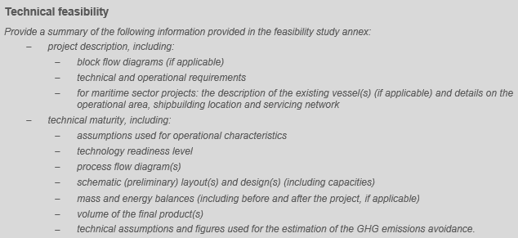
Technical Maturity: technical feasibility
Explain the degree of technology readiness of the proposed solution and the technical feasibility of delivering the expected output (e.g. in terms of quality and volume of the products):
Has the technology already been proven in a pilot scale demonstration?
Are the characteristics of the proposed plant credible and in line with basic engineering principles?
Are the technical assumptions realistic and conform with the state of technology development?
Provide robust and credible assumptions used for operational characteristics of the plant and estimation of the expected outputs
Provide clear reference to relevant parts of the Feasibility study and other supporting documents
For maritime sector projects: the description of the existing vessel(s) (if applicable) and details on the operational area, shipbuilding location and servicing network
Notes:
Explain the degree of technology readiness of the proposed solution and the technical feasibility of delivering the expected output (e.g. in terms of volume of the products) and, ultimately, achieving the GHG emissions avoidance within its operational environment. In particular:
Present clearly the assumptions used for operational characteristics of the plant and estimation of the expected outputs: have these been selected in a conservative yet accurate manner, i.e. to avoid under/over estimation of the estimated GHG emissions avoidance?

Slide 46
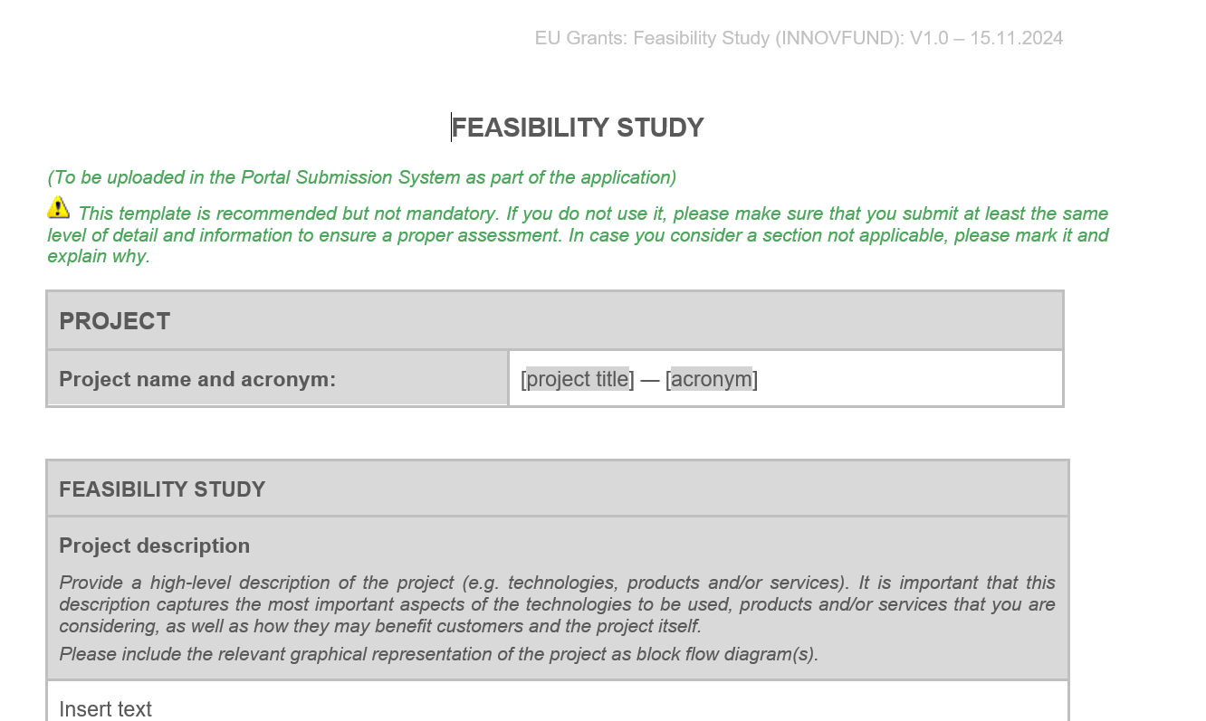
Feasibility study
Template available in the Submission System (under "Part B templates")
If the template is not used make sure that you submit at least the same level of detail and information to ensure a proper assessment.
The feasibility study should include:
    Project description
    Background information (existing situation)
    Location analysis and strategic approach
    Objectives
    Resources and feedstock availability
    Technical assessment
    Expected project output
    Techno-economic analysis

Slide 47
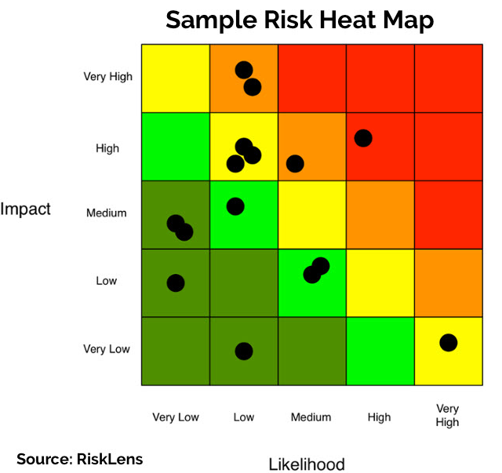
Risk analysis and management
Risks are included only in the Feasibility Study (mandatory annex) which must:
  Describe key risks that could impact the technical feasibility of the proposed technology/process
  Describe the impact if the risk materializes and the proposed risk mitigation measures and explain why they are suitable
  Summarize your analysis in a table (see template)
  Provide a risk heat map
Notes:
Focus on major technical risks

Slide 48
Lessons learned: Technical Maturity
Ensure full consistency between documents: Feasibility study, business plan, GHG calculations
Readiness level
Describe actual readiness level of your technology based on credible data:
Identify
Relevant data – from your previous stages: pilots / projects
Evidence
Due diligence report
Be concise
Be realistic
Provide key facts and figures
Include all relevant critical risks and mitigation strategies
Procurement quotes
MoU
Signed letters of intents/ support
Resubmissions are welcome, especially when TRL is improving!

Slide 49
Financial Maturity
Lara Tassan Zanin, Senior Financial Engineer

Slide 50
Financial Maturity award criterion 1/2
Objective: assess the project’s ability to reach Financial Close as soon as possible and no later than 48 months after GA signature
Credibility of the business model and plan
Financing plan
Credibility and soundness of the financing plan.
Solidity and commitment of project funders
Risks
Understanding of business and financial risks
Mitigation measures
Business plan
Robustness of cash flow projections and viability.
CAPEX, OPEX and revenue assumptions
Equity and Debt assumptions
Likelihood and impact of risks + credible and realistic mitigations
Fulfilment of minimum documentation requirements!
Quality and consistency sought!

Slide 51
Financial Maturity award criterion (2/2)
Financial Close=permit granted+FID (Final Investment Decision)+signed EPC/feedtstock supply/offtake+ signed credit facilities (all CPs met)+ other relevant contracts for the project to achieve operations as its targets
Narrative
Providing justification to the financial model (mainly Part B and Business Plan – FS and quotes for CAPEX)
Data
consistent with narrative and with third party’s evidence provided (FIF/RCs calculator and detailed Financial Model)
Evidence/Substantiation of assumptions by third parties
(mandatory and supporting documents)
Business and Financial Risks analysis
address likelihood and impact of BOTH business and financial risks including FID cross-dependencies
Risk analysis ≠ sensitivity analysis, yet consistency to be ensured!
Sensitivity analysis is an integral part of the Business Plan and detailed FM.
Better to identify and mitigate a risk than neglect it!

Slide 52
Financial Maturity - key documents (1/2)
Relevant proposal sections and mandatory annexes to be provided
Business plan (mandatory annex) - IF template highly recommended
Application Form Part B - Financial maturity (section 4.2)
Financial Information File (‘FIF’) - (mandatory annex) - To be filled with projections over expected project lifetime - includes the Relevant costs calculation, the grant disbursement schedule and the cost efficiency ratio calculation
Applicant’s detailed Financial Model (mandatory annex)- Project assumptions (i.e. with use of formulas, no hard coded figures, nor macros); funding sources and uses; forecasted P&L, cash flow and balance sheet statements, sensitivity analysis

Slide 53
Financial Maturity - key documents (2/2)
Relevant proposal sections and mandatory annexes to be provided
Project shareholders’ financial resources (mandatory annex) - Financial statements over last 3 years – further guidance in Annex 3
Project funding support (mandatory annex) - Minimum requirements in call text Annex 3
Project contract terms (mandatory annex)- Minimum requirements in call text Annex 3
Any existing due diligence report (optional - supporting document)
New
NB. Wherever contract and funding terms are not advanced/FC is far away, describe the strategy to secure key contracts with off-takers, key suppliers, construction contractors and funding arrangements. Otherwise, if advanced, provide in annexes contractual evidence, for example letters of support, indicative terms from MoU’s or LoI’s (see call text Annex 3)

Slide 54
Lessons Learned IF24 Call
92 proposals (out of 291 proposals passing A&E) failed under Financial Maturity
with 53 proposals failing on FM only (18% of evaluated proposals)
Main issues related to
the lack of credibility of the Business Plan
Fully describe, substantiate and evidence the main revenues, CAPEX and OPEX assumptions and include a detailed breakdown for all assumption of the Business Plan
See Annex 3 of call text for minimum requirements on project contract terms

Slide 55

Lessons Learned IF24 Call
Even projects with negative or low IRR can pass the Financial Maturity sub criterion thanks to solid letters of commitment from the project sponsors/shareholders => make sure the commitment letters recognise the issue of project profitability and confirm the willingness to implement the project.
92 proposals (out of 291 proposals passing A&E) failed under Financial Maturity
with 53 proposals failing on FM only (18% of evaluated proposals)
Main issues related to
the lack of credibility of the Financing Plan
Clearly identify all funding sources with their terms and conditions and the progress made in defining and/or negotiating them with funding counterparts.
Provide financial statements of the shareholder entities and evidence for debt assumptions
See Annex 3 of call text for minimum requirements on project funding support

Slide 56
6 Golden Rules of Financial Maturity
We recorded tutorials to fill in FIF/RCs calculator, business template, etc. Available on the EU Funds and Tenders portal.
Financial maturity
1. Commitment of project sponsors is evidenced, in particular if your project is not profitable
2. Business Plan assumptions are detailed, justified and fully substantiated
3. Financing plan is credible and complete
4. Follow Relevant Costs Methodology, in particular on how to calculate your project WACC
5. Mandatory annexes meet minimum requirements and all documents are consistent
6. Key business and financial risks are identified and properly mitigated

Slide 57
Relevant Costs (RCs) calculation/ Cost Efficiency
Lara Tassan Zanin, Senior Financial Engineer

Slide 58

Relevant Costs: Definitions
Relevant costs (“RC”) = The Relevant Costs shall be the net extra costs that are borne by the project proponent as a result of the application of the innovative technology related to the reduction or avoidance of the GHG emissions.
Relevant Costs =
best estimate of CAPEX and NPV of OPEX, Maintenance CAPEX net of Revenues and Operational Benefits of the project over a 10-year period
Maximum requested IF grant is 60% of total Relevant Costs!
The estimation of relevant costs should not include (examples):
Expansion Capex incurred after Entry into Operation
Terminal Value
Any costs incurred prior to Innovation Fund grant submission
Depreciation
Please refer to the RC methodology for full list of non-eligible items!

Slide 59
Relevant Costs - what has changed?
Clarification based on FAQ in the Helpdesk - for instance:
  the duration of the financial projections – over expected project lifetime
  rules on lease financing - applicable to all projects
  treatment of revenue arising from decommissioning – if any during first 10 years of operation
Additional guidance on boundaries for Relevant Costs calculation and revenue/cost assumptions for integrated projects
Update of the list of other excluded items – for example:
  Acquisition of producing assets/facilities commissioned and under operation before submission
  In-kind contributions
Update of definitions in Glossary definition (i.e. CAPEX, Lease, Operational Benefit, OPEX, Project lifetime)
Simplification of the WACC computation
Update on rules related to cumulation with other public support

Slide 60
Cost Efficiency award criterion
Important contribution to the score of your proposal!
Cost Efficiency is split in two sub-criteria:
  Cost efficiency ratio – automatic score
  Qualitative assessment on the computation of Relevant costs and the Cost Efficiency ratio
Cost efficiency ratio level has minimum requirements
(a) for all topics (except Pilots):
If cost efficiency ratio is lower than or equal to €200/tCO₂eq, score will be based on formula
12 – (12 x (cost efficiency ratio/200)
If cost efficiency ratio is higher than €200/tCO₂eq, proposal will be rejected under ‘Quality of the cost calculation and min requirements’
  (b) for Pilots:
  If cost efficiency ratio is lower than or equal to €2000/tCO2eq, score will be based on formula
  12 – (12 x (cost efficiency ratio/2000)
  If cost efficiency ratio is higher than €2000/tCO2eq, proposal gets zero score under ‘Quality of the cost calculation and min requirements’ but is NOT rejected

Slide 61
Cost Efficiency ratio
Depending on the topic, applicants choosing not to apply for the maximum grant will be more competitive when ranked against other applicants in ‘Cost Efficiency ratio’
* Please refer to the RCs methodology (Other public support) to best reflect any other subsidy granted or to be granyted to your project
Requested Innovation Fund grant + other public support*
=
Absolute GHG emission avoidance
During 10 years after entry into operation
Explained in the RCs methodology
Relevant proposal sections and mandatory annexes to be provided: Application Form Part B (section 7.1), Financial Information File (‘FIF’) / detailed financial model, and only Only for projects using ‘reference plant’ calculation methodology for relevant costs gor Other annexes (see section 5 of the call text).

Slide 62
If and how is ‘other public support’ included in RC/CE?
If public support is included in the project’s financial model → it has to be included in CE, cumulation rules might apply.
secured public support needs to be in the financial model and CE
otherwise: applicant’s choice.
Where to include it:
Updated
Must be included as “other public CAPEX subsidies” or “other public OPEX subsidies” on a non-discounted basis, in the “Financial Model Summary Inputs” sheet of the FIF
Support in the form of grants (CAPEX or OPEX), for which the amount received can be estimated with certainty at the moment of application
included in the numerator of the CE ratio
excluded from RC calculation
Support in the form of fiscal or parafiscal measures or tariff reduction resulting in lower operating costs (e.g. exemption of payment of levy/tax on power prices), contracts for difference, feed-in tariffs and indirect cost compensation
included in the RC calculation
not included in the numerator of the CE ratio
Must be included as Revenues, Operational Benefit or Other Revenues/OPEX Savings in the “Financial Model Summary Inputs” sheet of the FIF

Slide 63
Operational Maturity

Slide 64
Project Maturity: Operational Maturity
Application form, Part B, sections:
3.3 - Operational maturity
7.1 - Work Plan
7.2 – Work Packages, activities, resources and timing
Timetable-Gantt chart (mandatory document)
Participant information, including CVs and previous projects, if any (mandatory document)
Feasibility Study (mandatory document)
Due diligence report (if any)
Permits, licences, authorisations (if any)

Slide 65
Operational Maturity
Credibility and level of detail of the project implementation plan covering all project milestones & related deliverables
Project milestones must include at least financial close, entry into operation and annual reporting after the entry into operation (guidance provided in the call text and application form Part B)
Provide a clear timeline from signature of the grant agreement up to the end of the operation period; ensure consistency between the text in the application form Part B and the Gantt chart (mandatory annex)
Key aspects: strategy to reach financial close and entry into operation; ensure adequate timing of planned activities during plant construction; regular operation of the technology during operation period
The project implementation plan must be consistent with work packages, milestones and deliverables described in section 9 of the application form Part B
Ability to reach entry into operation in line with market standards in the sector or faster
Notes:
Overall 5 points to address under OM
The plan for implementing the project must be sufficiently developed, comprehensive and realistic.
Ability to reach entry into operation in line with market standards in the sector or faster
the Gantt chart (mandatory annex and use the template

Slide 66
Operational Maturity
State of play and credibility of the plan for obtaining required permits, rights or licences, and other regulatory procedures
Included a summary of the key information provided in the project description section of the feasibility study:
Key aspects to be covered: detailed analysis of the regulatory framework; any intellectual property rights or licence; other relevant regulatory procedures; relevant permitting processes needed (including permits related to environmental impacts)
State of play: description of permits already obtained and still needed and the plan for obtaining them, including timeline indicating the relevant permit application dates, expected reception dates and measures planned to ensure timely granting

Slide 67
Operational Maturity
Soundness of the public acceptance strategy
Detailed description of all environmental impacts expected throughout the whole project life-cycle (from construction to operation to decommissioning), and associated mitigation measures
Degree of public acceptance of the technology and the project
Clear and specific steps planned be ensured public acceptance (please do not limit to generic explanations of the issue)

Slide 68
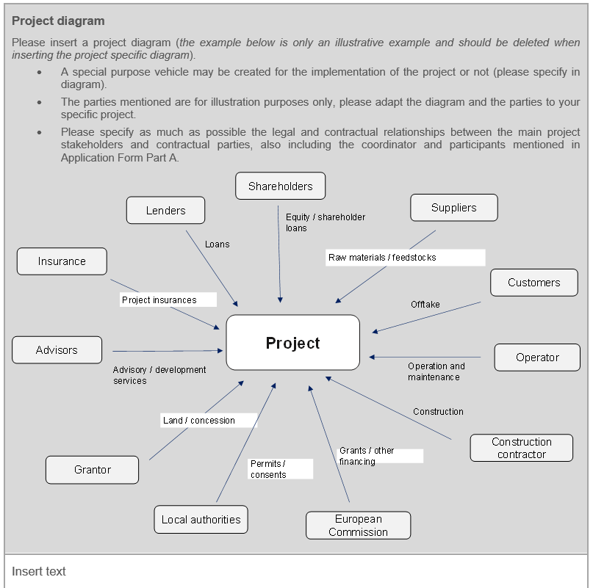
Operational Maturity
Relevance & track record of the project management team and soundness of the project organisation
Project management team, e.g.: key qualifications and track record; sufficient coverage of all necessary skills; provide justifications on the need for additional outside resources
Project organisation, e.g. project management structure; governance, responsibilities and decision-making mechanisms and processes within the consortium; quality management, health and safety
Provide a project diagram visualising the involved actors and organisation of the project
Notes:
GT to double check

Slide 69
Operational Maturity
Operational risks and credibility of proposed mitigation measures
Risks are included only in the Feasibility Study and Business plan (mandatory documents) which must:
  Describe the main operational risks associated with the construction (for example timing), project design, operation (for example weather conditions) and decommissioning, or risks stemming from dependencies from other projects relevant to the project
  Describe the impact if the risk materializes and the proposed risk mitigation measures and explain why they are suitable
  Summarize your analysis in a table (see template)
  Include a Risk heat map
Notes:
GT to double check

Slide 70
Lessons Learned: Operational Maturity
Operations
Define solid Work Packages and tasks
Timeline
Ensure consistency between Gantt & tasks/ WPs (interdependencies)/ FiF
Clear Strategy
Clearly identify project parties and responsibilities
Set clear and realistic deliverables, milestones and means of verification
Include relevant operational risk assessment in the Feasibility Study
Ensure availability of necessary know-how in the team
Consider realistic timing for:
Construction and supply
Obtaining permits, rights and licences
Ensuring public acceptance
Potential delays
Clear Role distribution
Link Work Packages and corresponding financial costs
Set a clear strategy for:
Construction, considering targets/ deadlines & needs
Obtaining permits, rights and licenses for a defined location
Ensuring public acceptance
  Provide contractual evidence: letters of support, MoUs, indicative terms of agreement for off-take agreements, key suppliers, quotes from vendors, EPC parties

Slide 71
Replicability

Slide 72
Replicability
Application form, Part B, sections:
4.1 – Replicability
  Replicability in terms of efficiency gains and multiple environmental impacts
  Compliance with DNSH TSC criteria for environmental objectives other than ‘climate change mitigation’
  Contribution to Europe’s industrial leadership and competitiveness
4.2 - Knowledge sharing — Communication, dissemination and visibility
Updated

Slide 73
Efficiency gains and environmental impacts
Explain how the project addresses possible resource constraints through:
  efficient use of resources
  reduction in consumption of critical raw materials
  sustainable biomass and other scarce resources
  or other ways to address resource constraints in terms of efficiency, circularity, recycling and recyclability of such resources
Describe the potential or the proposed solution to address multiple environmental impacts (for example, increasing biodiversity protection, reducing land, air and water pollution)
Notes:
Both in the short- / medium-term (during transition to a climate-neutral economy) and in the long-term (in a climate-neutral economy).
Always substantiate your comments as the project proposals will be assessed based on quality, soundness and reliability of the information provided

Slide 74
Compliance with DNSH TSC criteria for environmental objectives other than ‘climate change mitigation’
Updated
Explain how compliance with the ‘do no significant harm’ technical screening criteria (TSC) set out in Annex II to Delegated Regulations 2021/2139 and/or 2023/2486 will be ensured for the environmental objectives other than ‘climate change mitigation’ and provide an outline of the plan how these criteria will be fulfilled (see Annex 4 of the Call document)
Note: Compliance with the objective ‘climate change mitigation’ must be described in section 2.3 in part B

Slide 75
Contribution to Europe’s industrial leadership and competitiveness
Contribution to new industrial ecosystems (e.g.: clusters, working with the European suppliers) and/or integration with strategic energy infrastructure (e.g.: projects connected to PCIs)
Building the European know-how: creation and retention of intellectual property (IP) and technologies within the EU/EEA; cooperation with EU/EEA-based universities, research institutions and industry actors, capacity-building activities (e.g., trainings), knowledge sharing plan outline, demonstrated efforts on due diligence on the supply chain.

Slide 76
Contribution to Europe’s industrial leadership and competitiveness
Where relevant:
  mitigating critical dependencies and diversifying the sourcing of critical raw materials;
  mitigating critical dependencies on final products or their main specific components from the third countries on which the EU has an identified dependency as identified in the Commission Communication (C/2025/3236) linked to the Net Zero Industry Act.
For maritime sector projects, ability to strengthen the EU’s maritime transport value chain, including port activities, increased competitiveness and job creation in the EU maritime sector, demonstrated coordination on the development of Green Corridors (see Glossary in call text)

Slide 77
Knowledge sharing
Communication, dissemination and visibility
Knowledge sharing goals:
De-risking innovative low-carbon technologies with regard to wide-scale commercialisation
Acceleration of deployment
Increasing the undertaking of, and confidence in these technologies by the wider public
Maintenance of a competitive market for the post-demonstration deployment of the technologies

Slide 78
Guidance for Completing the Knowledge Sharing Section
Check thoroughly Call text Annex 2
Outline activities, content, tools, channels and target groups for knowledge-sharing that go beyond the mandatory knowledge-sharing requirements (such as reporting and participation in knowledge-sharing events organised by the granting authority). For example:
  participation and organisation of technical and scientific events, trainings, lectures
  participation in working groups and discussion fora
  organisation of site visits, construction of a visitors centre, etc.
Describe how the visibility of EU funding will be ensured
Quality, soundness and reliability of the information should be provided
NOTE:
For successful projects, a detailed knowledge sharing plan has to be provided as deliverable in month 1 (see section 10 of the Call document)
Please refer to the “Knowledge Sharing report template” available on the Funding & Tenders portal for information only at submission stage to better understand the information to be provided during project implementation
Notes:
Outline the activities, content, tools, channels and target groups for knowledge-sharing that go beyond the mandatory knowledge-sharing requirements (i.e. reporting and participation in knowledge-sharing events organised by the granting authority; see knowledge-sharing report available on the Funding & Tenders Portal Reference Documents for minimum requirements).
These can include but are not limited to: participation and organisation of technical and scientific events, trainings, lectures, participation in work groups and discussion forums, organisation of site visits, construction of a visitors centre, etc.
Describe how the visibility of EU funding will be ensured.
Note: For successful projects, a detailed knowledge sharing plan has to be provided later on, , as deliverable in month 1 of the grant (see section 10 of the Call document).

Slide 79
Bonus points 2 and 3

Slide 80
Bonus point 2: SMEs
Only for projects coordinated and implemented by small and medium-sized enterprises (SMEs)⁴⁴ as defined in the EU SME Recommendation 2003/361
Application form, Part B, Section 6
New

Slide 81
Bonus point 3: Maritime sector projects
Only for projects in the maritime sector!
Application form, Part B, Section 6
Projects that have a demonstrated potential for decarbonising the maritime sector and reducing its climate impacts.

Slide 82
Do No Significant Harm
Principle

Slide 83
‘Do No Significant Harm’ (DNSH) in the IF
Requirements
  Innovation Fund must ensure¹ that all projects (both auctions and regular grants) meet “do no significant harm” criteria from IF25 onwards
  Screening must be done against the Technical Screening Criteria (TSC) listed in the Climate Delegated Regulation and Environment Delegated Regulation supplementing the EU Taxonomy Regulation
Key Points
Not all EU Taxonomy obligations apply (e.g. no need for ‘significant contribution’)
All previously eligible sectors remain eligible to the Innovation Fund, with conditions
Environmental Objectives
Climate Change Mitigation
Climate Change Adaptation
Water and Marine Resources
Circular Economy
Pollution Prevention and Control
Biodiversity and Ecosystems
¹Article 10f of the ETS Directive

Slide 84



DNSH Assessment & Compliance Process
Application
DNSH Compliance Plan
End of Operation
DNSH Compliance Report
  Evaluation of DNSH Compliance Plan
Report demonstrating DNSH Compliance
throughout the project lifetime
  Additional monitoring and verification may be added during the Grant Agreement Preparation Phase

Slide 85
Preparing the DNSH Compliance Plan
Step 1
Select relevant economic activity(ies)
Step 2
Find Technical Screening Criteria (TSC) for those activities
Step 3
Prepare the DNSH Compliance Plan for Application Form Part B
Assess compliance and identify necessary actions

Slide 86
IF25 Heat Auction:
Objectives and design

Slide 87
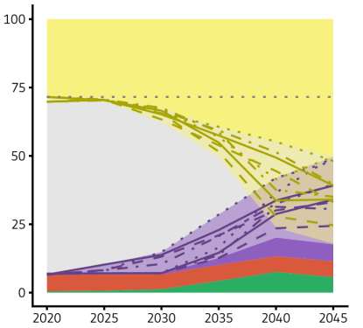
Why decarbonisation of industrial process heat?
Final energy share, Industry (in %)
Electrification: main vector of industry decarbonisation by 2030 and beyond
Industrial process heat today is largely fossil fuels based, only 4% of industry’s energy needs for process heat are electrified
Cost gaps compared with fossil-fuels-based technologies hinder market ramp-up
Type of projects underrepresented in IF portfolio
With such a large potential across the EU, applications are possible by companies of all sizes, in all industrial sectors and in all EEA countries
Today, we are here.
Electrification ramp-up should start now
Scenario:
Hydrogen
Scenario: Electrification
Energy carrier
Hydrogen + E-Fuels
Electricity
District Heating
Fossil fuels
Biomass
Data: Falko Ueckerdt et al. (2021): Taking off despite uncertainties: Key points of an adaptable hydrogen strategy. How policymakers can find hydrogen pathways to climate neutrality by 2045. Ariadne policy brief

Slide 88


The heat auction in a nutshell
Objectives:
Reduce GHG emissions cost-effectively by supporting the market ramp-up of industrial process heat decarbonisation technologies
Act as a pilot for the Industrial Decarbonisation Bank as announced in the Clean Industrial Deal
Eligible technologies:
Projects that electrify industrial process heat via technologies such as heat pumps, electric boilers, resistance heating, induction heating, plasma torches, electric shockwave heating
Projects that use direct renewable heat (solar thermal and geothermal) for industrial processes
Hybrid projects of the above-mentioned technologies

Slide 89
Auction Topics and eligible activities
Medium Temperature
Small Scale
  € 150 Million + Spanish AaaS of
  € 30 Million
  >=3 <5 MW_{th}
  100-400 ºC
  €100 Million max grant amount
Medium Temperature
Larger Scale
  € 350 Million + Spanish AaaS of
  € 20 Million
  >=5 MW_{th}
  100-400 ºC
  €100 Million max grant amount
High Temperature
  € 500 Million
  >=3 MW_{th}
  >400 ºC
  €250 Million max grant amount

Slide 90
Auction Design: (2) qualifications
WHAT
Admissibility
Eligibility
Relevance: will the project produce decarbonized heat (with electrified or direct RES solution)? Will it lead to the direct GHG abatement?
No ‘resilience’ requirements for heat equipment or components because no established dependencies (or risks)
Quality: is the project sufficiently mature (basic technical, financial, and operational maturity checks)?
Do No Significant Harm (DNSH) check
A financial capacity and legal entity check before the grant agreement to ensure that successful applicants can implement the project
HOW
Pass/Fail assessment
Application Form A, B, C
Mandatory documents
  Participant information
  Cost calculator
  Timetable/Gantt chart
  Feasibility study
  Permits, licences and authorisations
  Completion guarantee letter of intent
  Others: Heads of Terms or other forms of pre-contractual signed term sheets (from equipment providers, suppliers, off-takers), Equity supporting evidence

Slide 91
Bid ranking
The heat auction has a total budget of EUR 1 billion (‘constraining value’ of the auction)
Bids will be ranked on price forming a bidding/merit order curve
Bids also need to pass qualification requirements
The auction will be cleared where the budget is exhausted (clearing price)
The number of projects and volume of heat supported is thus a function of the available budget and the size and prize of submitted bids within given topics.
Example of an auction bidding curve

Slide 92
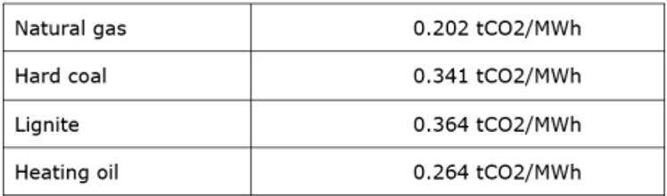
Bid definition: Subsidy for GHG Abatement
Automatic Conversion with applicants choosing either:
1. the phase 4 ETS heat benchmark (default) or
2. the emissions factor of the fuel replaced in the installation
Project Input:
€/MWh
Bid:
€/tCO₂
Incentivises decommissioning of fossil fuel installations
Choice of bidders
Bidders must provide proof of decommissioning if selecting option #2

Slide 93
Bid definition: flexibility requirements
Objective: supporting electricity grid balancing and avoid emissions/system costs linked to peak hours – flexible demand or energy storage are encouraged.
Option 1:
Default
Maximum payment equal to 70% of hours
Option 2:
Flexible Ramping Schedule
Maximum payment equal to 80% of hours
Indicate can follow a flexible ramping schedule
Checked ex-post, penalties apply if not implemented
Option 3:
Energy Storage
Maximum payment equal to 100% of hours
Storage sufficient to replace electricity consumption from the grid for 4h by 20% within 1h
Checked ex-ante only
Option 4:
Heat Pump/Direct Renewables
Maximum payment equal to 100% of hours
Heat Pumps with CoP > 2.0; or
Direct Renewable Heat

Slide 94
Main technology eligibility requirements
Eligible
Not Eligible
  Industrial process heat electrification technologies, e.g.:
    Heat pumps
    Direct and indirect resistance heating
    Electromagnetic and dielectric heating
    Plasma heating
  Direct renewable heat technologies (solar-thermal or geothermal)
  Combination of the above
  Non-heat processes in industry
  Heat production for space heating or sale to district heating
  Electric arc furnaces for steel-making
  Electrolysis processes (e.g. in the aluminium sector)
  Biomass or hydrogen use
  Projects that involve new fossil fuel-fired capacity (except glass furnaces or where technical/safety restrictions exist)
  Heat pumps can reuse waste heat from (existing) industrial processes but not from power generation, district heating, waste incineration
  Activities which do not comply with Do No Significant Harm principle

Slide 95
Obligations
Max time to reach Financial Close
2 years after signing the Grant Agreement
Demonstrating that all contracts are signed and conditions in them fulfilled
To be approved by the granting authority
Sanctions: the grant agreement terminated, calling the completion guarantee
Max time to reach Entry into Operation
4 years after signing the grant agreement.
Demonstrating as operational a nameplate thermal capacity (and eligible temperature levels) for the equipment of at least 100% of that expressed in the bid.
To be approved by the granting authority.
Sanctions: the grant agreement terminated, calling the completion guarantee
  Direct or indirect measurement of industrial process heat volume and temperatures according to ISO 50001 management system
  Automatic formula will translate it into the GHG abatement
  Level of output should not decrease below 30% of expected annual volume (for 3 years in a row)
Reporting every 6 months after EiO
95

Slide 96

Application process – Admissibility and compulsory documents
Technical description
Up to 50 pages
Administrative info & summarised budget
Application Form B
Mandatory annexes & supporting documents
Part C
Application Form A
Proposals must be:
submitted before the call deadline
submitted electronically
complete
readable, accessible, printable
Project’s contribution to EU programme KPIs

Slide 97
Innovation Fund 2025
Hydrogen Auction
Lara TASSAN ZANIN
10 December 2025

Slide 98
The European Hydrogen Bank - Overview
Domestic market creation
Fixed premium auction(s) under the Innovation Fund (DG CLIMA)
Imports to the EU
Instrument for renewable hydrogen imports TBD
Cooperation with H₂ Global (DG ENER)
Transparency and coordination
Demand assessments
Hydrogen flows
Infrastructure needs
H₂ cost data
Existing European financing instruments
InvestEU
Structural funds
Innovation Fund grants
Existing international financing instruments
Concessional loans
Blending
Guarantees

Slide 99




Innovation Fund Hydrogen Auction objectives
Putting Europe’s net-zero industry in the lead:
Allowing for
price discovery and renewable hydrogen market formation
Reducing the
cost gap between renewable and fossil hydrogen in the EU
De-risking European
hydrogen projects
Reducing
administrative
burden

Slide 100
IF H2 Auctions so far
2023
2024
2025
IF23 Auction [Pilot]
€ 800 M
RFNBO Hydrogen
1 topic - general
IF24 Auction
€ 1 200 M
RFNBO Hydrogen
2 topics:
  General (€ 1 000 M)
  Maritime (€ 200 M)
IF25 H2 Auction
€ 1 300 M
RFNBO and ELC Hydrogen
3 topics:
  General RFNBO(€ 600 M)
  General RFNBO & ELC (€ 400 M)
  General RFNBO & ELC for Maritime & Aviation (€ 300 M)
132 proposals received
6 awarded projects
61 proposals received
15* pre-selected projects
7 projects withdrew and 10 additional ones from reserve list invited
* Projects invited to Grant Agreement Preparation: final list of awarded projects only by December 2025

Slide 101
The IF25 Hydrogen Auction: Overview
Production of Hydrogen in Europe - EUR 1.3 Billion
Topic 1:
Budget: EUR 600 M
Product: RFNBO H2
Off-takers: no restriction
Topic 2:
Budget: EUR 400 M
Product: RFNBO H2 and Electrolytic Low Carbon H2
Off-takers: no restriction
Topic 3:
Budget: EUR 300 M
Product: RFNBO H2 and Electrolytic Low Carbon H2
Off-takers: Restricted to aviation or maritime off-takers

Slide 102
Auctions-as-a-Service (AaaS)
EEA countries can use the competition to allocate additional national funds to national projects > projects positively evaluated but not selected by the IF due to limited budget, can choose to be proposed for MS budget.
Streamlined State-Aid notification process
Avoid unnecessary administrative burden of developing & running new support scheme
2023
2024
2025
IF23 Auction [Pilot]
Germany: + € 350 M
IF24 Auction
Spain: + € 400 M
Austria + € 400 M
Lithuania: + € 36 M
IF25 H2 Auction*
Germany: + € 1.3 bn (Topic 1)
Spain: + € 415 M (Topic 1, Topic 3)
* Official announcements and special conditions of the funding can be checked in the National Authorities’ websites.

Slide 103
General eligibility conditions
Location of the project: within the EU/EEA (no virtual production)
Installed capacity: min. 5 MWe, new capacity, single location (no virtual capacity pooling)
Projects must limit the sourcing of electrolysers and its components from China
Off-takers: restrictions depending on the topic
Bid ceiling price: € 4 / kg RFNBO or Electrolytic Low Carbon Hydrogen (ELC)
Maximum size of the grant: Topic budget for all topics

Slide 104
Key implementation arrangements
Financial close: within 2.5 years after signing Grant Agreement
Entry into Operation (EiO): within 5 years after signing Grant Agreement
Completion guarantee: 8% of the requested grant - covers reaching Financial Close & EiO under the call requirements
Payments: no payments before EiO; then, biannual basis - €/kg of Hydrogen produced, certified & verified (RFNBO and/or ELC) for a maximum period of 10 years

Slide 105
Key implementation arrangements 2/2
Production requirements: semi-annual production may be increased to up to 140% of planned. Total grant amount cannot be increased. Production of volumes that are part of the bid cannot fall < 30% of planned production for more than 3 rolling consecutive years
Compliance with the criteria during implementation: for Topic#3, monitoring of aviation-maritime off-takers, resilience criteria, and certification of 70% GHG savings on overall production
Cumulation with other public funding: limitations apply

Slide 106
New: Electrolytic Low Carbon Hydrogen
The adoption of the Delegated Act (EU) 2025/2359 now provides a clear methodology to certify and verify the production of low carbon hydrogen. For the IF25 H2 Auction, eligibility is limited to low carbon hydrogen that is produced from an electrolyser.
This product will only be eligible for projects applying into Topics 2 and 3. Projects applying to Topic 1 can still produce non-RFNBO H2, but will receive no payments for it.
Definition of Low Carbon Hydrogen (DIR(EU) 2024/1788): “means hydrogen the energy content of which is derived from non-renewable sources, which meets the greenhouse gas emission reduction threshold of 70 % compared to the fossil fuel comparator for renewable fuels of non-biological origin set out in the methodology for assessing greenhouse gas emissions savings from renewable fuels of non-biological origin and from recycled carbon fuels, adopted pursuant to Article 29a(3) of Directive (EU) 2018/2001”

Slide 107
New: Electrolytic Low Carbon Hydrogen
There will be a single bidding price covering ELC and RFNBO hydrogen volumes
At application stage, the electricity sourcing strategy will need to demonstrate that the project will be able to produce electrolytic low carbon hydrogen with the installed capacity of the electrolyser that will comply with the minimum emissions thresholds of the definition of Directive 2024/1788 and following the GHG calculation methodology of its Delegated Act.
During implementations, sub-volumes of ELC and RFNBO hydrogen may vary, as long as the total volume of hydrogen produced respects the production requirements.
Payments will only be received upon certified and verified volumes. Voluntary Schemes for low carbon fuels are expected to be ready during 2026.

Slide 108
New: Resilience Criteria
The adoption of NZIA Implementing Act (REG (EU) 2025/1176 creates reference pre-qualification and award criteria for auctions for the deployment of energy from renewable sources, including resilience contribution criteria for electrolysers. The IF25 H2 Auction is now fully aligned with NZIA requirements.
At least 75% of the electrolysers included in the project must originate in a country different than China. For those at least 75% of the electrolysers:
  stacks must originate in a country different than China
  no more than two of main specific components may originate in China (stacks cannot count for these two components).
Simplification: In IF25 H2 Auction, no ISO standards are required anymore and the information requested from the electrolyser manufacturer has also been simplified (e.g no information CRM content

Slide 109
New: Resilience Criteria
Cybersecurity requirements: are now fully aligned with NZIA’s IA.
  Project to explain how it will comply with security by design requirements
  Operational control of the installation established in the EEA: the operational control of the electrolyser must be carried out by an entity established in the EEA.
  Data stored and processed within the EEA: the project’s data is stored and processed either on the project/company own server in their premise in EEA or on the cloud but, in this case, the data centre serving this cloud has to be in the EEA.
Reminder of existing rules under the Foreign Subsidy Regulation (FRS), State aid and Trade Defence Instruments (TDI)
  FRS: Investigations to companies established in the EU that might have received foreign subsidies, which could distort the competition in the internal market
  TDI: Investigations to unfair trade practices focusing on companies established outside the EU (e.g. subsidy schemes, dumping practices affecting all sector etc.)

Slide 110
New: Aviation and Maritime topic
The Sustainable Transport Investment Plan (STIP) adopted in November 2025, announced that the Innovation Fund would open under its European Hydrogen Auctions a dedicated EUR 300M topic to hydrogen producers supplying to aviation and maritime off-takers.
Projects applying to Topic 3 must supply at least 60% of the expected total volume of hydrogen production that is part of the bid to off-takers belonging either to the maritime or aviation sector.
At application stage, the off-take strategy must credibly demonstrate that the project will comply with this requirement. The required Head of Terms with off-takers must include a self-declaration from the off-taker confirming that they belong to the maritime or aviation sector together with documentation supporting it.
Monitored throughout the project’s operation

Slide 111
New: Financial Maturity requirements
Based on the experience of previous auctions, we want to ensure higher levels of information concerning the financial maturity of the projects at application stage.
More substantiated information for the progress financing and business plan.
More detailed information about understanding of risks of credible mitigation measures, particularly concerning infrastructure the project may be dependent on.
commitment from main project sponsors - through MoU/Letter of Intent from Equity Providers

Slide 112

Become a project evaluator for the Innovation Fund
Technical experts
Financial experts
GHG experts
Rapporteurs
Sign up as an expert (europa.eu)

Slide 113









Stay informed
clima-innovation-fund@ec.europa.eu
cinea-communication-if@ec.europa.eu
@EUClimateAction
Subscribe to our mailing list
@EUClimateAction
@cinea_eu
cinea.ec.europa.eu/programmes/innovation-fund_en
EU Environment & Climate
@EUClimateAction
European Climate, Infrastructure and Environment
Executive Agency
@EUClimateAction
@CINEATube
@ourplanet_eu

Slide 114
Thank you
© European Union 2025
Unless otherwise noted the reuse of this presentation is authorised under the CC BY 4.0 license. For any use or reproduction of elements that are not owned by the EU, permission may need to be sought directly from the respective right holders.

